Slide 1
SMART SHOPPING ASSISTANCE FOR VISUALLY IMPAIRED PEOPLE
AUTHOR VIJAY T

Slide 2

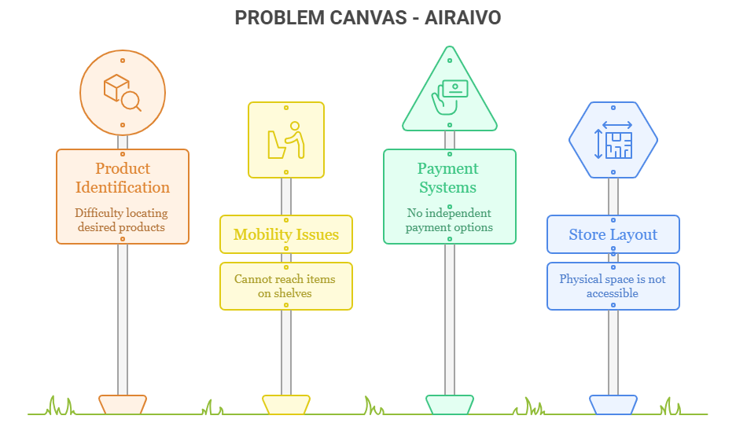
PROBLEM:
Most retailers have failed to introduce arrangements or facilities in order to facilitate independent shopping for persons who have any form of physical disability.
Compared to conventional retailing models, the existing solutions do not provide any kind of support for disabled customers
3. Many disabled customers experience difficulty when trying to locate or identify products, such as being unable to read the label, the mobility to reach and grab an item and having impaired eyesight, is not easily accessible

Slide 3
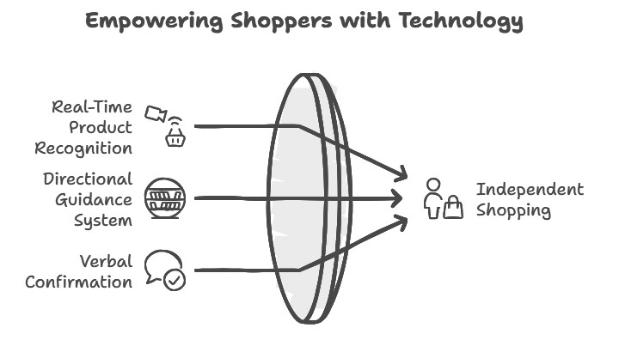
SOLUTION:
A camera module attached to an electronic component called the system performs real-time product recognition and barcode scanning
This innovative approach enables people with physical disabilities to shop independently.
In addition to the guidance system and the ability to provide verbal confirmation of added items to their virtual cart and real-time checkout totals

Slide 4
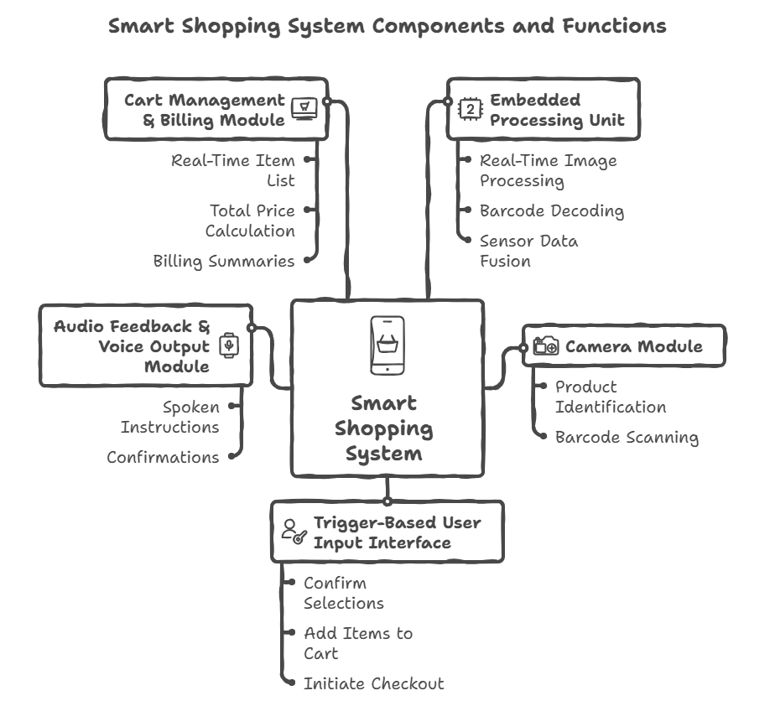
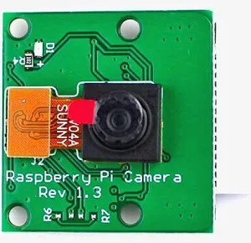
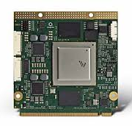

COMPONENTS AND FUNCTION
KEY COMPONENTS
Embedded Processing Unit
Camera Module
Trigger-Based User Input Interface
Cart Management & Billing Module
Audio Feedback & Voice Output Module

Slide 5
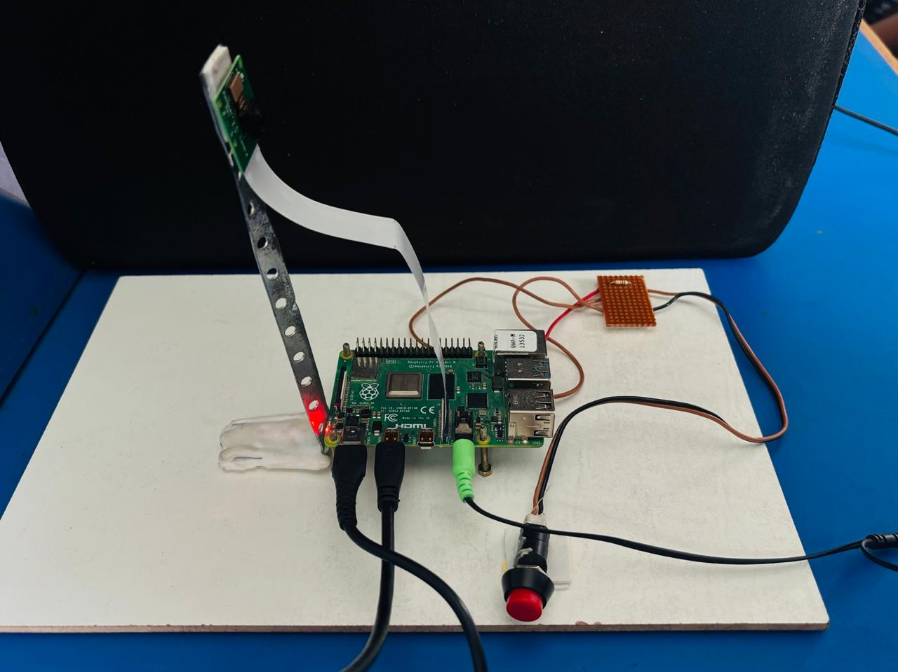
CURRENT STATUS​ / TECH STACK:
TRL 7 is achieved
The prototype is built and demonstrated
in a real-world environment
The development of the assistive shopping system is further advanced than originally thought.
Currently, the system has moved past the concept phase and is now in prototype development and testing.
The current prototype incorporates critical elements of the hardware, such as the processing unit, camera and navigation sensors; therefore, users will experience improved reliability and portability as refinement continues.
TRL7: End-to-end functionality:
Object detection
Barcode scanning
Voice guidance
Cart creation & billing

Slide 6

SDG 11 — Sustainable Cities and Communities
Contributes to inclusive urban environments by improving safe navigation in public spaces.
SDG 3 — Good Health and Well-Being
Enhances mental and physical well-being by increasing mobility and confidence.
SDG 8 — Decent Work and Economic Growth
Improves employability and productivity by making travel to workplaces safer and more reliable.
SDG 4 — Quality Education.
Supports independent learning and exploration
SDG 10 — Reduced Inequalities
Promotes social inclusion and equitable access to services and spaces.
SDG 9 — Industry, Innovation and Infrastructure
Encourages technology innovation that supports accessibility.

Slide 7
CONCLUSION:
Our Solution provides an intelligent, accessibility-focused shopping assistant that facilitates opportunities for persons with physical disabilities to shop independently
We have developed an integrated system that uses multiple technologies to support real-time product identification, safe aisle navigation, and billing through audio interaction with embedded vision and navigational assistance, thus enabling users to shop independently without the need to depend on staff or other caregivers.
Results:
The result of these efforts is a more scalable, affordable and practical solution for both individuals as well as retailers and institutions seeking to provide access to their goods and services to persons with physical limitations.

